Slide 1
NEW BORNS
WELCOME
Seth Dhirja Mal Birthday Celebrations – 2019

Slide 2
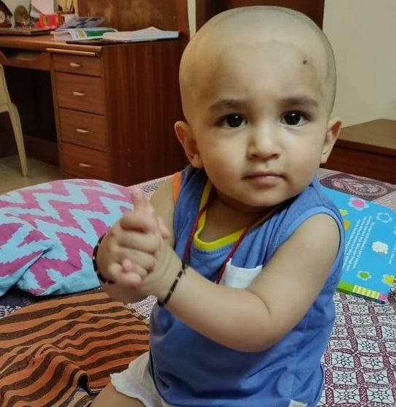
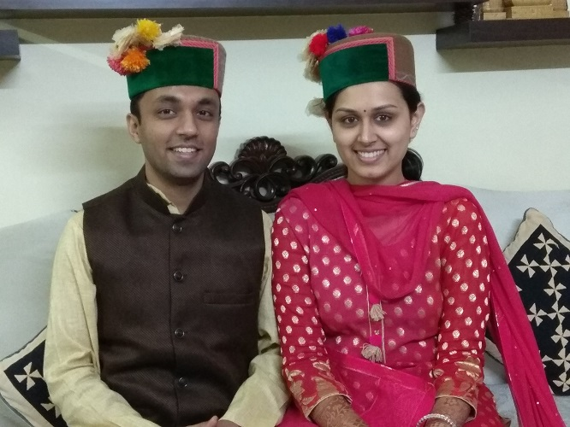
Amey Aggarwal (11th Generation) S/O Sh. Abhishek and Smt. Apurva Aggarwal → Amey S/O Abhishek S/O Adarsh S/O Sat Prakash S/O Devi Dayal S/O Shiv Saran Das S/O Duni Chand S/O Masadi Mal S/O Devi Ditta Mal S/O Sada Sukh S/O Dhirja Mal

Slide 3
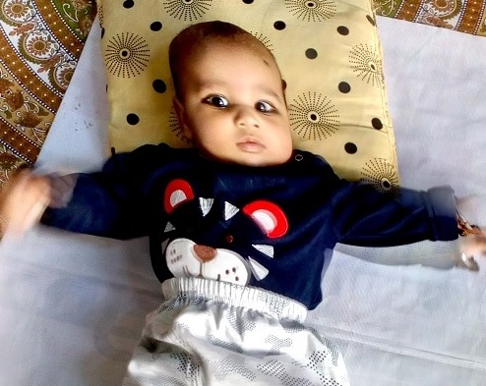
Sidhik Gupta (11th Generation) S/O Sh. Gaurav Garg and Smt. Sonia Garg → Sidhik S/O Gaurav S/O Radheyshyam S/O Amer Singh S/O Moti Ram S/O Ghiga Ram S/O Harbilas S/O Gurditta Mal S/O Devi Ditta Mal S/O Sada Sukh S/O Dhirja Mal

Slide 4
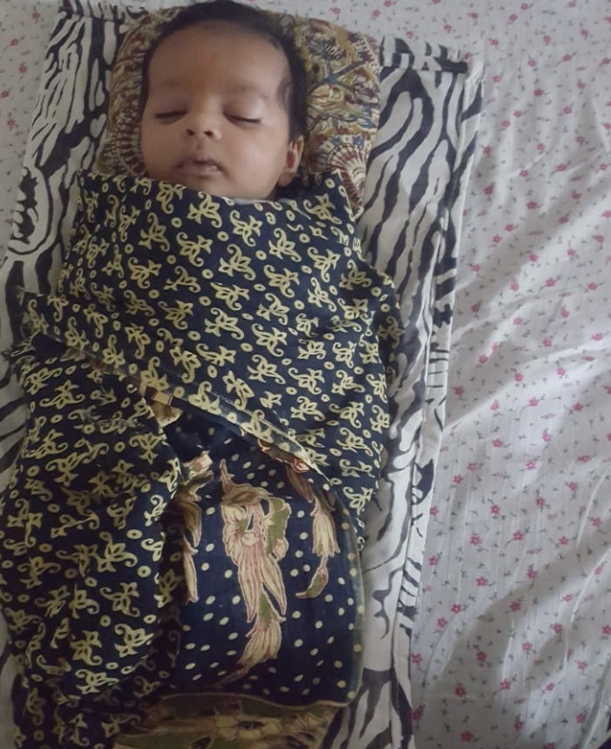
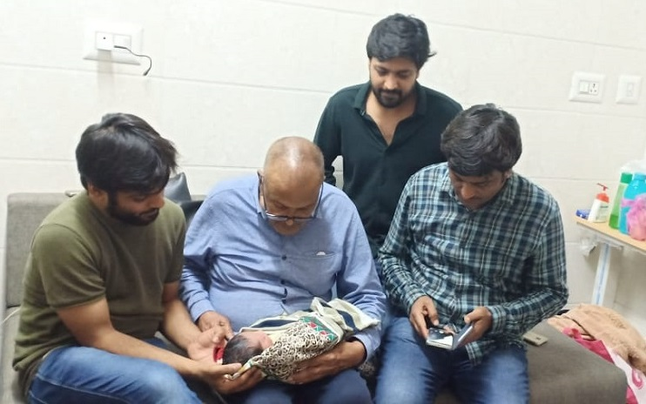
Ivaan Garg (10th Generation) S/O Sh. Abhishek and Smt. Nikita Garg → Ivaan S/O Abhishek S/O Ved Bhushan S/O Yash Pal S/O Bansi Lal S/O Anant Ram S/O Bhagat Ram S/O Deviditta Mal S/O Sada Sukh Mal S/O Dhirja Mal

Slide 5
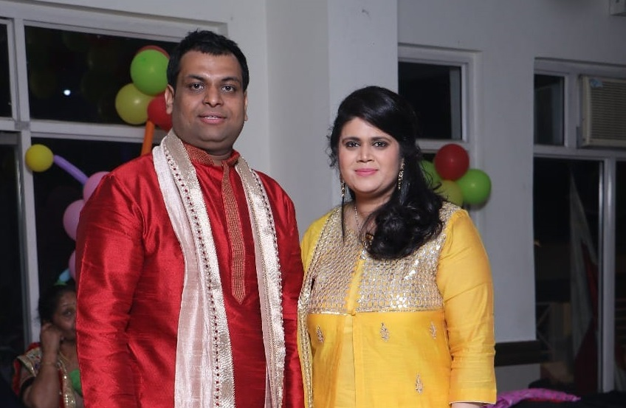
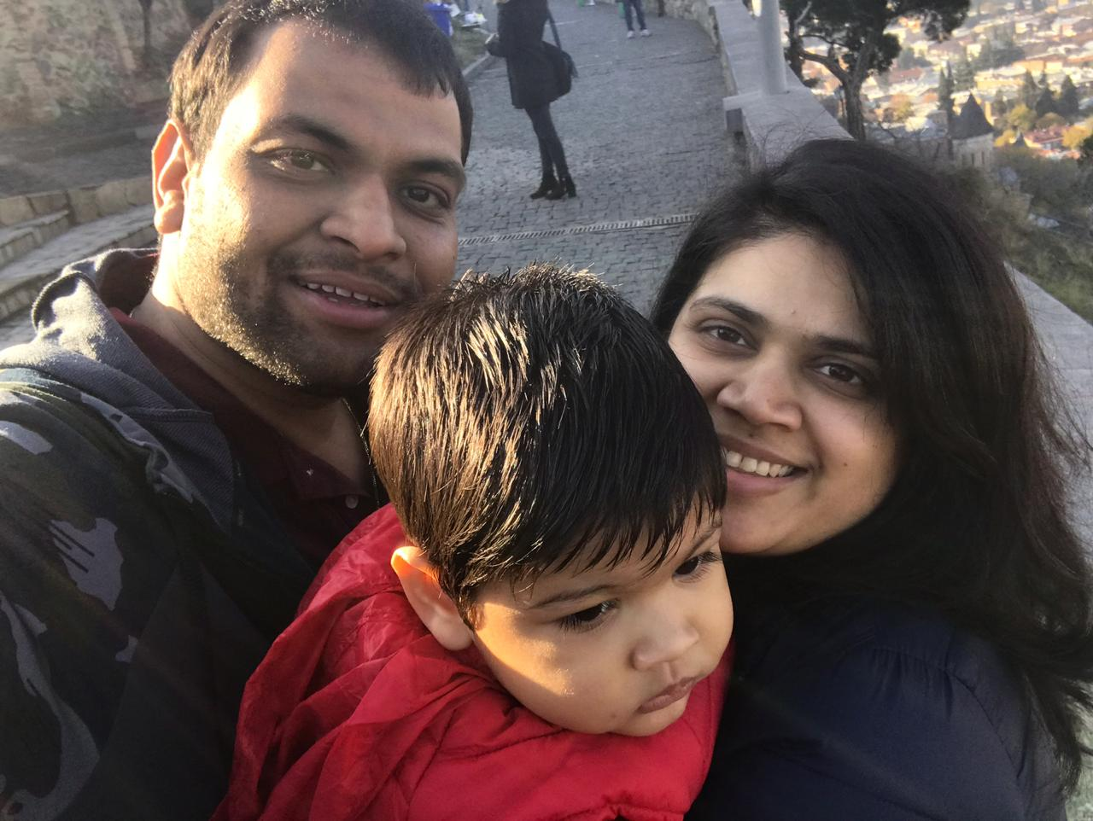
Vihan (10th Generation) S/O Sh. Chirag and Smt. Tanvi → Vihan S/O Chirag S/O Jitender (Jatti) S/O Narinder S/O Jaithu S/O Ram Gopal S/O Kripa Ram S/O Jayanti Mal S/O Sada Sukh Mal S/O Dhirja Mal

Slide 6
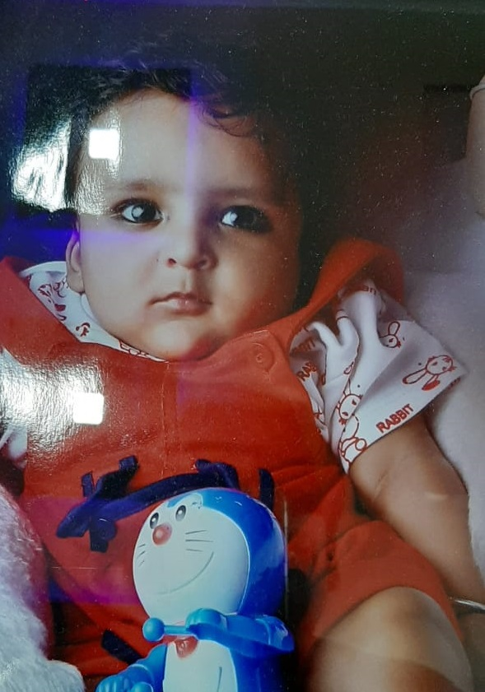
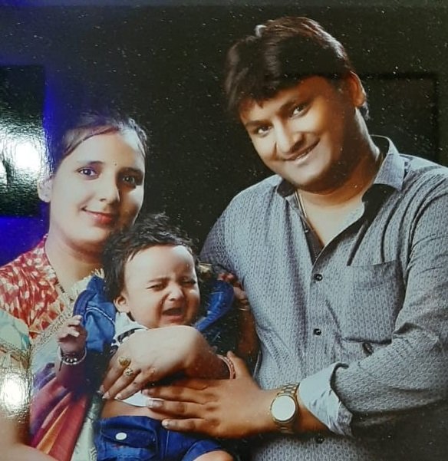
Yuvam Garg (11th Generation) S/O Sh.Ashu → Yuvam S/O Ashu S/O Pankaj S/O Girish S/O Puran Chand S/O Bicha mal S/O Giga Mal S/O Gurditta Mal S/O Devi Ditta Mal S/O Sadasukh Mal S/O Dhirja Mal

Slide 7
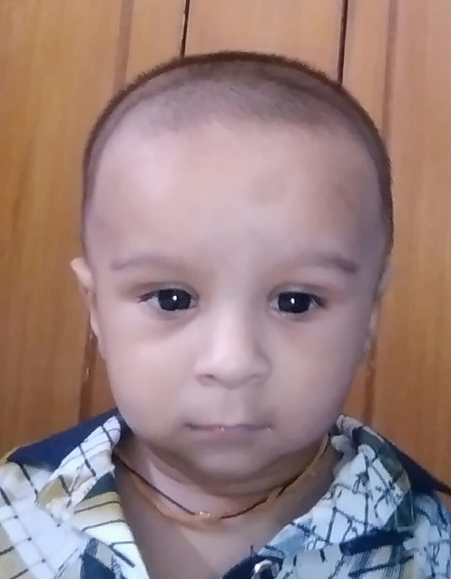
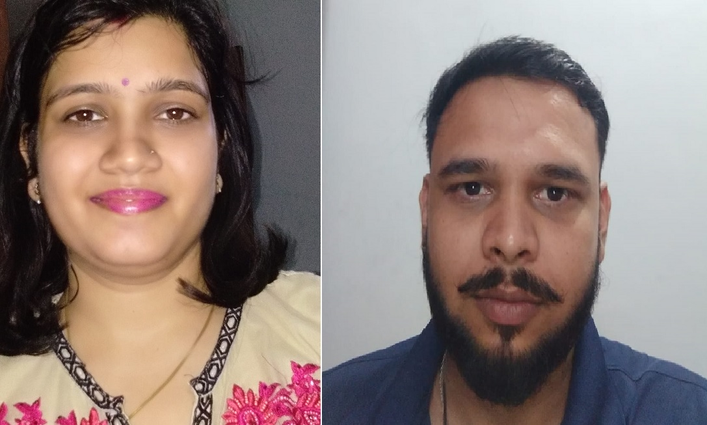
Aaphesh Garg (11th Generation) S/O Sh. Ankur → Aaphesh S/O Ankur S/O Bharat Bhushan S/O Om Prakash S/O Pyare Lal S/O Shiv Saran S/O Duni Chand S/O Masadi Mal S/O Devi Ditta Mal S/O Sadasukh Mal S/O Dhirja Mal

Slide 8
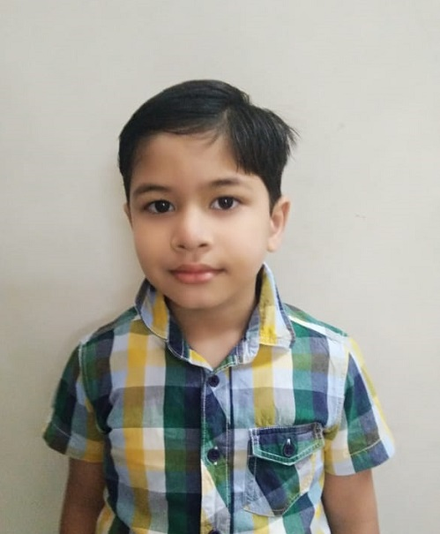
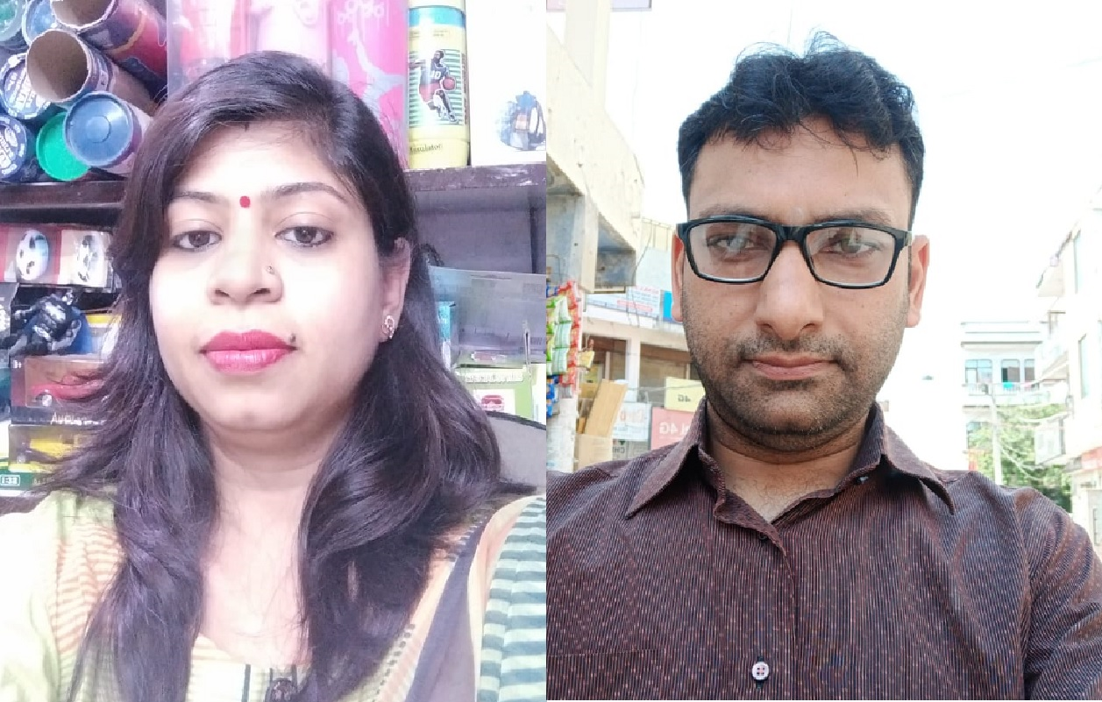
Akshobhay Garg (11th Generation) S/O Sh. Ashish → Akshobhay S/O Ashish S/O Sushil S/O Puran Chand S/O Pyare Lal S/O Shiv Saran S/O Duni Chand S/O Masadi Mal S/O Devi Ditta Mal S/O Sadasukh Mal S/O Dhirja Mal

Slide 9
Thank You

